Slide 1
Crack Detection and Segmentation using Image Based and Deep Learning Techniques
Presentation by Nikhil Mittal and Dip Banik
12/6/2023

Slide 2
Outline
Introduction
Existing Methods
Image Processing Based Approach
Machine Learning Based Approach
Results
Conclusion
Future Directions
References

Slide 3
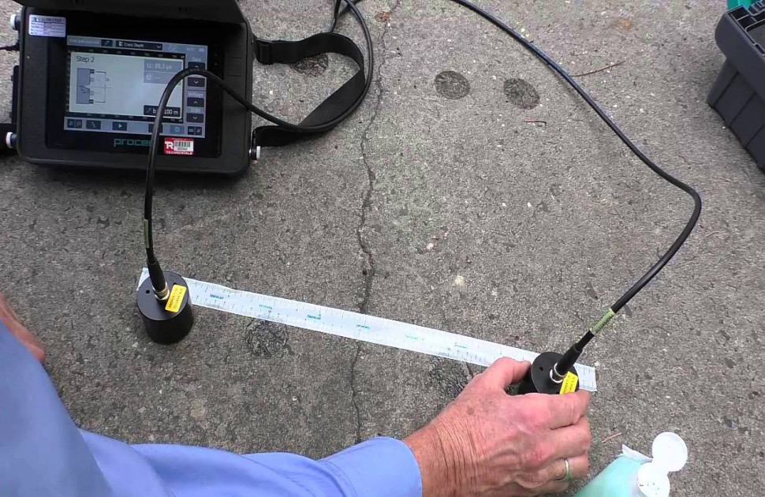
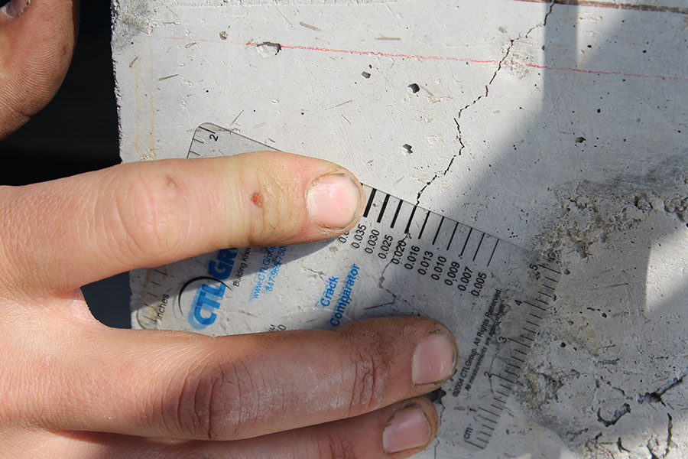
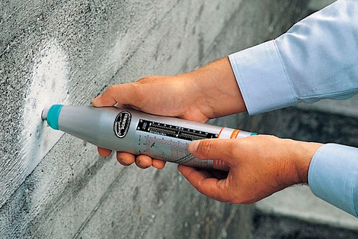
Introduction
Importance of Crack Detection
Timely repairs
Reduced maintenance cost
Ensure safety
Ensure performance
Manual Crack Detection
Time consuming and tedious
Risky oftentimes
Prone to error
Automatic Crack Detection
Ensure frequent maintenance
Safer detection approach
Cost efficient

Slide 4
Existing Methods
Pixel-based Methods:
Thresholding: Binarize image
Edge Detection: Identify sharp intensity changes
Region-based Methods:
Morphological Operations: Extract features by dilation and erosion
Pattern Recognition and Machine Learning:
Genetic Programming: Uses evolutionary principles
Percolation Model: Simulates crack propagation
Machine Learning Techniques: Utilizes CNN
Other Methods
Frequency Domain Analysis: Converts image to frequencies
Wavelet based Methods: Decompose image at different scales
Fractal Analysis: Measures self similarity of cracks
Statistical Methods: Extracts texture information

Slide 5
Image Processing Based Approach

Slide 6
Architecture
Morphological Operations
Image Thresholding
Connected Objects Detection
Objects Filtering
Segmentation
Crack Width Calculation

Slide 7
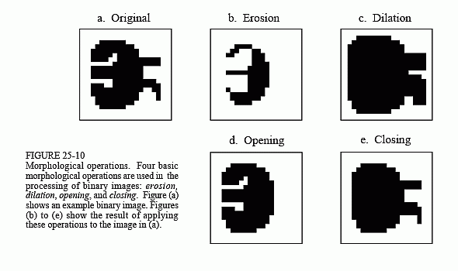
Morphological Operations

Slide 8
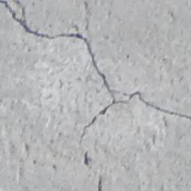
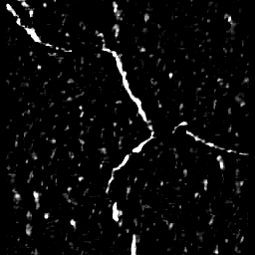
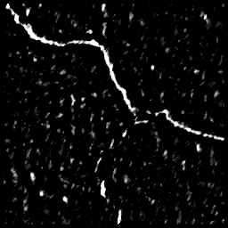
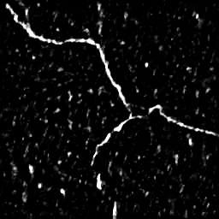
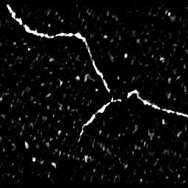
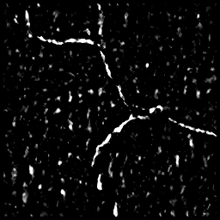
Morphological Operations
Original Image
Structuring element 0°
Structuring element 45°
Superimposed Image
Structuring element 90°
Structuring element 135°

Slide 9
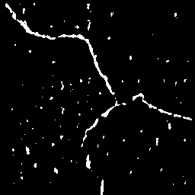
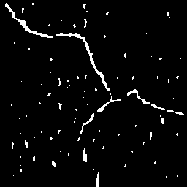
Image Thresholding/ Binarization
Otsu Thresholding
Closing Operation on Binarized Image (For false negatives)
Image after Morphological Operations
Binarized Image
Image after closing operation

Slide 10
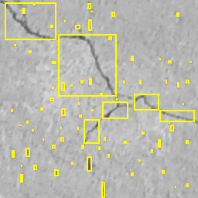
Connected Objects Detection
Identify objects using pixel connectivity in 8 directions

Slide 11
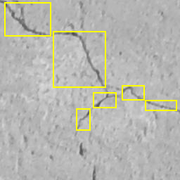
Objects Filtering
Objects are filtered with number of pixel enclosed > 20
Diagonal size of box > 30

Slide 12

Segmentation
Pixels identified as cracks are highlighted

Slide 13
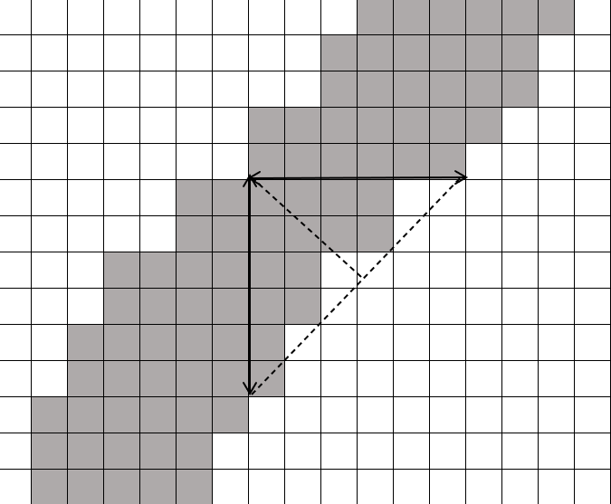

Crack Width Calculation
Crack width in horizontal and vertical direction are w1 and w2
Actual crack width can be calculated based on the following equation
w₁
w_{c}
w₂

Slide 14
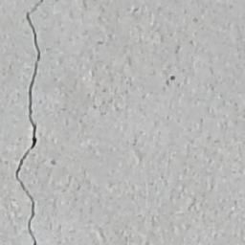
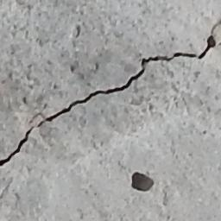
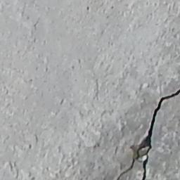
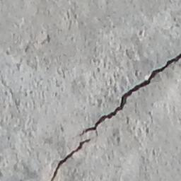

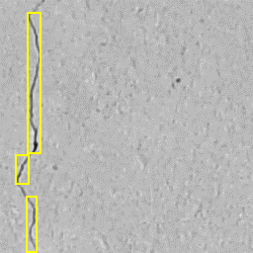
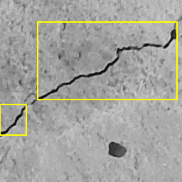
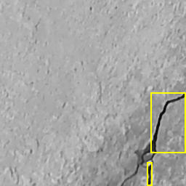
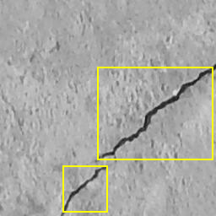




Output - Examples

Slide 15
Machine Learning Based Approach

Slide 16
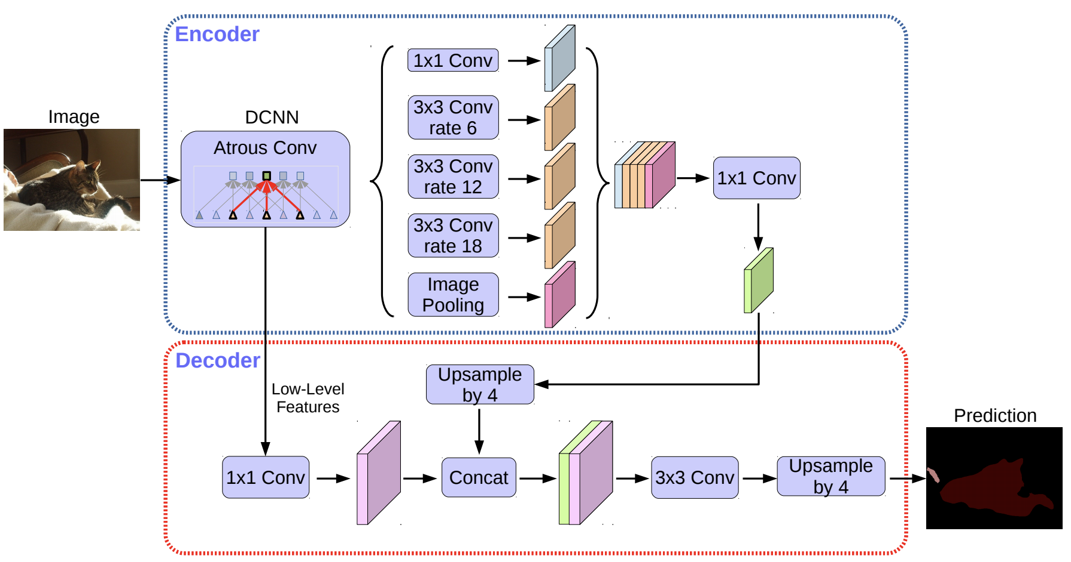
Architecture
Deep Lab V3+ Architecture
State of the art
Encoder Decoder Architecture includes ASPP module

Slide 17
Training Variables
Trained on dataset with 150 images annotated and segmented
Uses Resnet18 network
Stochastic Gradient Descent With momentum (SGDM)
Down sampling factor 16

Slide 18
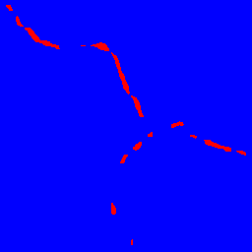




Output - Examples

Slide 19
Results
Confusion matrix built for 20 images from test dataset
For Image Processing Based Approach crack width estimation had high accuracy with average error of less than 10%
For Machine Learning Based Approach crack width estimation had high accuracy with average error of less than 20%
Normalized Confusion Matrix
Image Processing Based Approach
Machine Learning Based Approach
Predicted Class
Predicted Class
 | Crack | Concrete
Crack | 85.8% | 14.2%
Concrete | 1.60% | 98.40%
 | Crack | Concrete
Crack | 69.2% | 30.8%
Concrete | 0.52% | 99.48%
True Class
True Class

Slide 20
Conclusion and Future Directions
Image Processing based approach outperformed the Machine learning based approach
Image processing based approach crack detection can be a viable alternative for manual crack detection.
Continued research and development is needed to improve the current models.
Incorporating hybrid approaches that combines image processing based approach and machine learning approach based could be a better solution.

Slide 21
References
Munawar HS, Hammad AWA, Haddad A, Soares CAP, Waller ST. Image-Based Crack Detection Methods: A Review. Infrastructures. 2021; 6(8):115. https://doi.org/10.3390/infrastructures6080115
Jahanshahi, M. R., &amp; Masri, S. F. (2011). A novel crack detection approach for condition assessment of structures. Computing in Civil Engineering (2011). doi:10.1061/41182(416)48
Chen, L.-C., Zhu, Y., Papandreou, G., Schroff, F., &amp; Adam, H. (2018). Encoder-decoder with atrous separable convolution for Semantic Image segmentation. Computer Vision – ECCV 2018, 833–851. doi:10.1007/978-3-030-01234-2_49

